Slide 1
Unit 3: Intro to Libraries
DIVERSE LIBRARIANSHIP CAREER TRAINING AND EDUCATION PROGRAM
[presenter’s names]

Slide 2
SESSION OUTLINE
MAIN TOPICS
Brief History of Libraries
Types of Libraries Library Services Library Criticism Looking Forward

Slide 3
When you hear the word " l ibrary" what' s the first
thing that comes to mind?

Slide 4
Brief History

Slide 5
The first library
The first systematically organized library in the ancient Middle East was established in the 7 th century BCE by Assyrian ruler
Ashurbanipal in Nineveh, in contemporary Iraq.
It contained approximately 30, 000 cuneiform tablets assembled by topic. Many of the works were archival documents and scholarly
texts, but there were also works of literature, including the ancient Epic of Gilgamesh.
Like many bibliophiles, Ashurbanipal was very protective of his
library. An inscription in one of the texts warns that potential thieves would face the wrath of the gods.

Slide 6
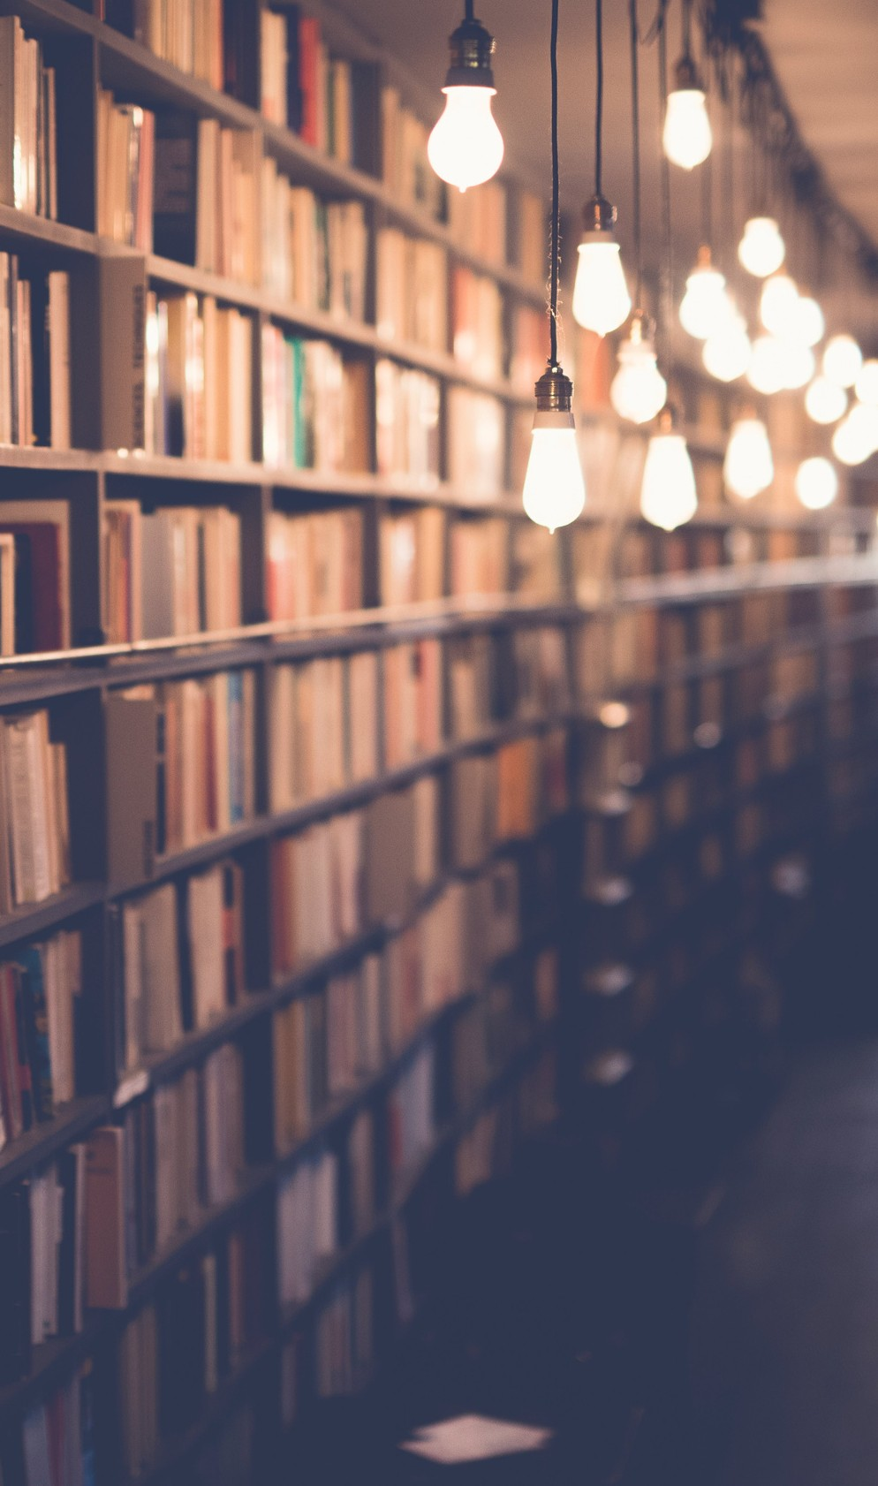
REPOSITORIES OF INFORMATION
Eastern/Western Religious Preservation Practiced preserving christian bibles and religious information before the printed word
Most commonly cited: Great Library of Alexandria
Large Repositories of Evidence
Artifact and culturally significant items stored to capture moments in history: Politics, poetry, philosophy
Modern-Day Library Repositories
Curated selection of books and materials to serve a population or community

Slide 7
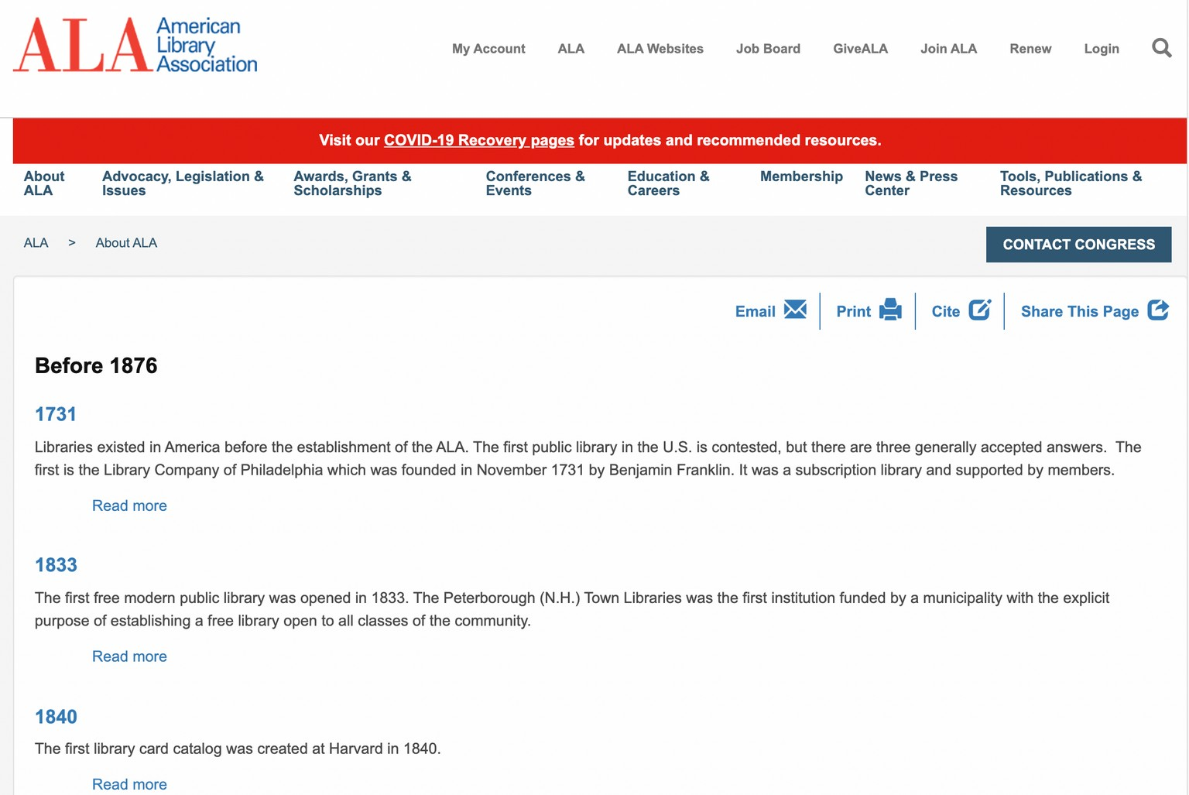
CULTURAL RESPONSIBILITIES & FAILURES
White Washing
Cultural Theft
Exclusion based on religious ideology
Racial Exclusion & Neglect

Slide 8
Types of Libraries

Slide 9
LIBRARY TYPES
Academic Libraries
Academic Libraries serve colleges and universities, their students, staff and faculty. Larger institutions may have several libraries on their campuses dedicated to serving particular schools such as law and science libraries.
Public Libraries
Public Libraries serve communities of all sizes and types. As the name implies, public libraries serve the general public, "from cradle to grave" as more than one public librarian has been heard to say. Public libraries often have departments that focus on areas of service, such as youth, teens and adults.

Slide 10
LIBRARY TYPES
School Libraries
School Libraries are usually part of a school system, and serve students between Kindergarten and grade 12. Many are called media centers, and librarians are often required to have a second degree in education or a certificate in school media.
Special Libraries
Special libraries offer unique opportunities to work in a specialized environment of interest, such as corporations, hospitals, the military, museums, private businesses, and the government. Special libraries can serve particular populations, such as the blind and physically handicapped, while others are dedicated to special collections, such as the Library of Congress or a presidential library.

Slide 11
Library Services

Slide 12
RESOURCES & COLLECTIONS
Connecting Learners to Resources
Books, journal articles, government documents, maps, media, images, video, movies, documentaries, etc.

Slide 13
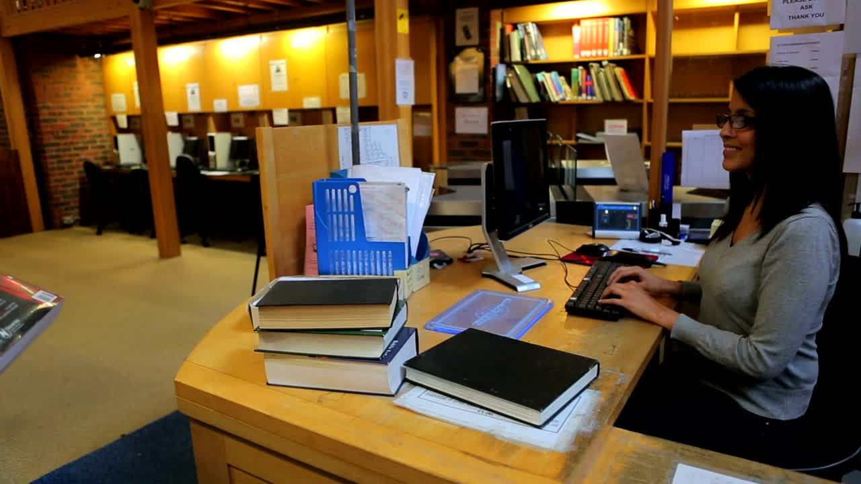
INFORMATION &
"REFERENCE" ASSISTANCE
Quick Library Help
Librarians are available to help library visitors to understand their information need, find materials & information, and teach users how to access library information themselves.

Slide 14
TEACHING & LEARNING
Information, Tech, & Media Literacy
Librarians often visit classrooms and/or hold instruction sessions on basic/in-depth information literacy skills and many other resource- centric instruction.

Slide 15
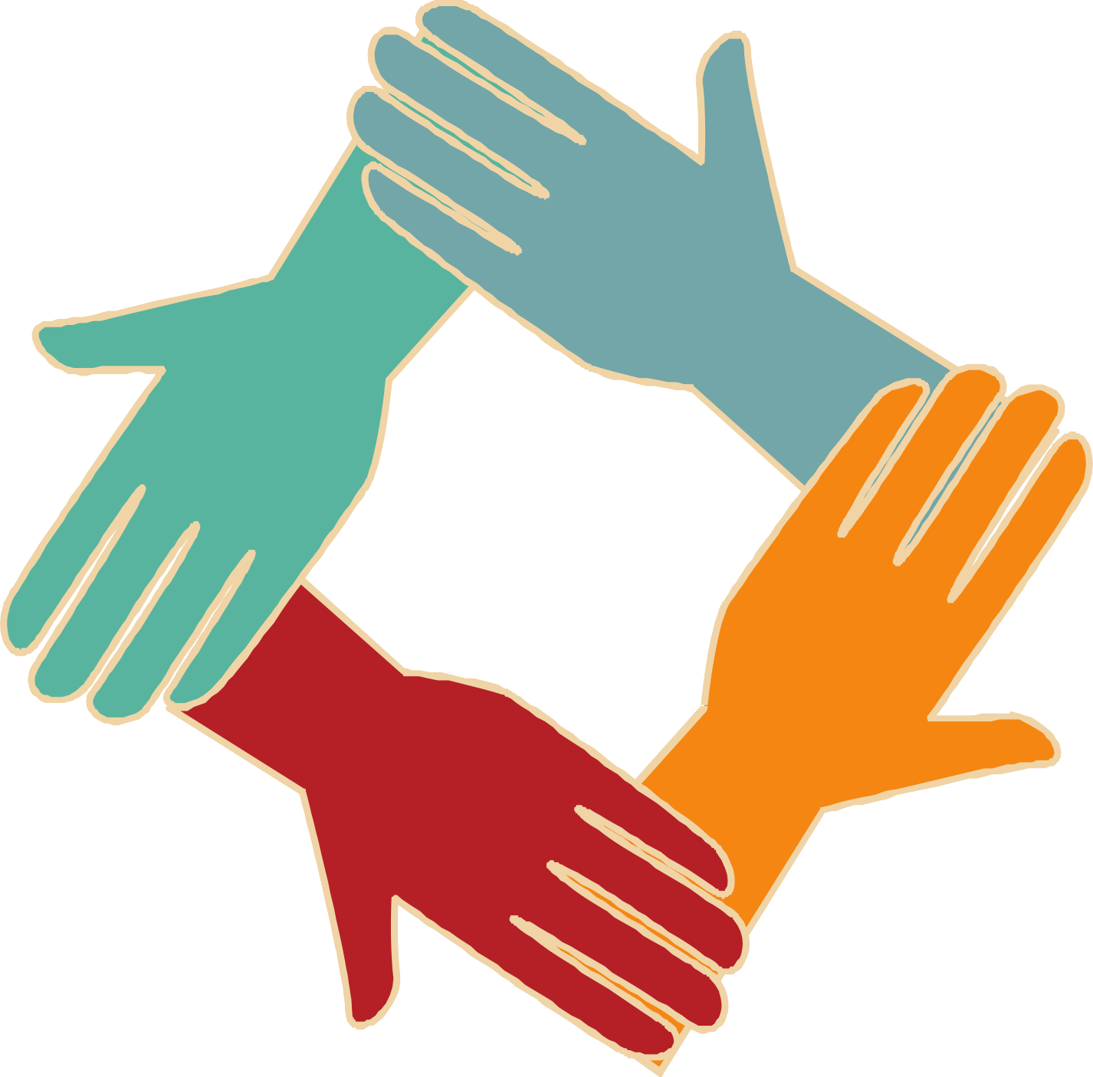
COMMUNITY
ENGAGEMENT & PROGRAMMING
Lifelong Learning
Librarians & Library Staff develop programs based on community interest, needs, and trends to learn new things and connect with others.

Slide 16
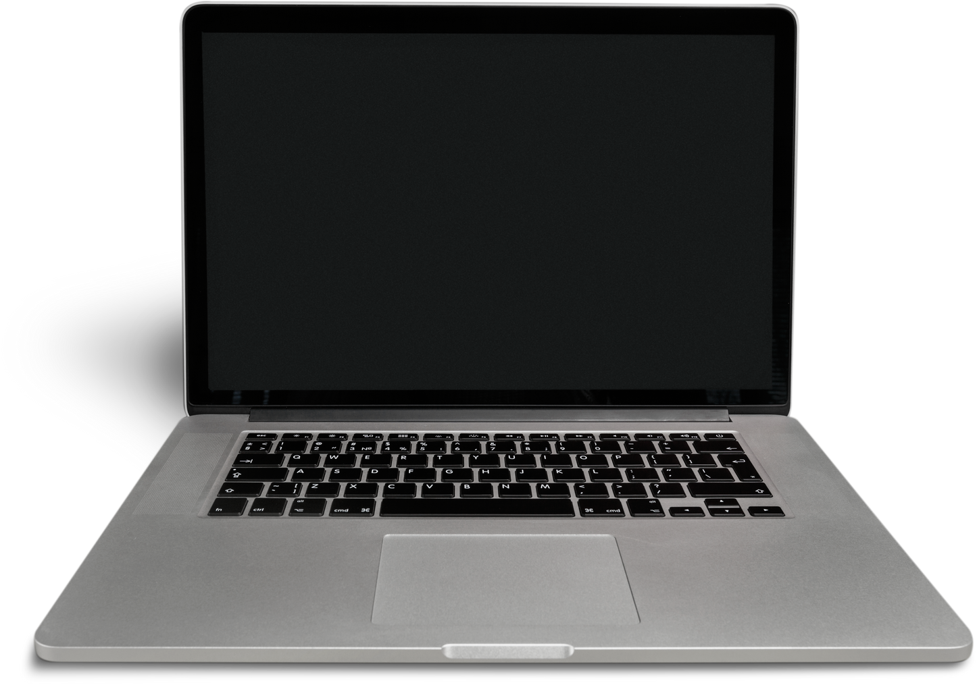
TECHNOLOGY
Computer Literacy & Equipment Lending
Libraries offer access to computers and other tech resources.

Slide 17
Library Criticism

Slide 18
(VERY) BRIEF OVERVIEW
Open, but not to all
American libraries have served large population and communities but, historically, have left certain populations out of the narrative
Cultural and archival theft
Much like the theft of American museums, libraries have stolen precious material from native and marginalized cultures to "preserve" them for future generations
White-centric collections
Librarians are continuing to comb through collections to weed out or differentiate harmful material while enabling collections to represent real communities

Slide 19
Looking Forward:
The future of libraries

Slide 20
CORRECTING COURSE
Diversity, Equity, Inclusion, Antiracism
Dr. Sandra Toro, Senior Program Officer at IMLS, read from the evaluation: “ It is also important to prepare
all librarians for work in a multicultural society,
particularly because the recruitment and education of diverse individuals to serve the communities they
represent takes time, both to enter the ranks and later assume leadership positions”

Slide 21
Re-Imagining Libraries
What is a library in the 21st Century?

Slide 22
IF YOU RAN A LIBRARY, WHAT WOULD YOU FILL IT WITH?

