Slide 1
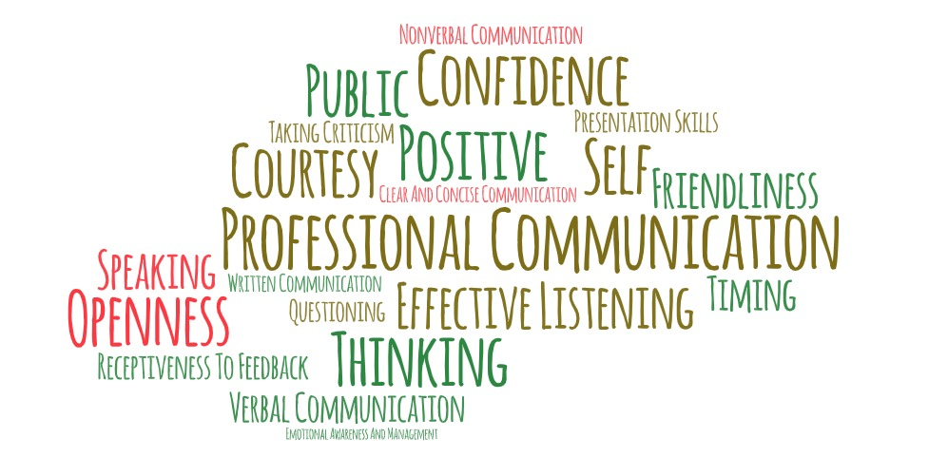
Communication and teamwork
And tools to help with both

Slide 2
Competencies for communication and teamwork
Know the basic concepts of interpersonal relations, customer service, teamwork, and communication.
Select the most appropriate medium for communicating with library users and coworkers.
Resolve conflict in a positive and productive manner.
Practice proactive customer service by anticipating user needs.

Slide 3
Competencies for communication and teamwork (cont'd)
5. Use effective verbal and non-verbal communication.
6. Know how to communicate difficult or sensitive information.
7. Seek, give, and accept constructive feedback from co-workers, supervisors, and users.
8. Participate effectively on teams, commit to agreed-upon goals and objectives, communicate respectfully and professionally, and support team decisions.
Adapted from Library Support Staff Certification Program Communication and Teamwork Competency Set, https://ala-apa.org/lssc/for-candidates/competency-sets/communication-and-teamwork/ and Linking Libraries, Episode 902: Communication and Teamwork from Central Minnesota Libraries Exchange, https://cmle.org/episode-902-communication-and-teamwork/

Slide 4
Know the basic concepts of interpersonal relations, customer service, teamwork, and communication
This will allow you to become better at serving library users.
This will allow you to become more successful with coworkers.
It is not enough to be nice.

Slide 5
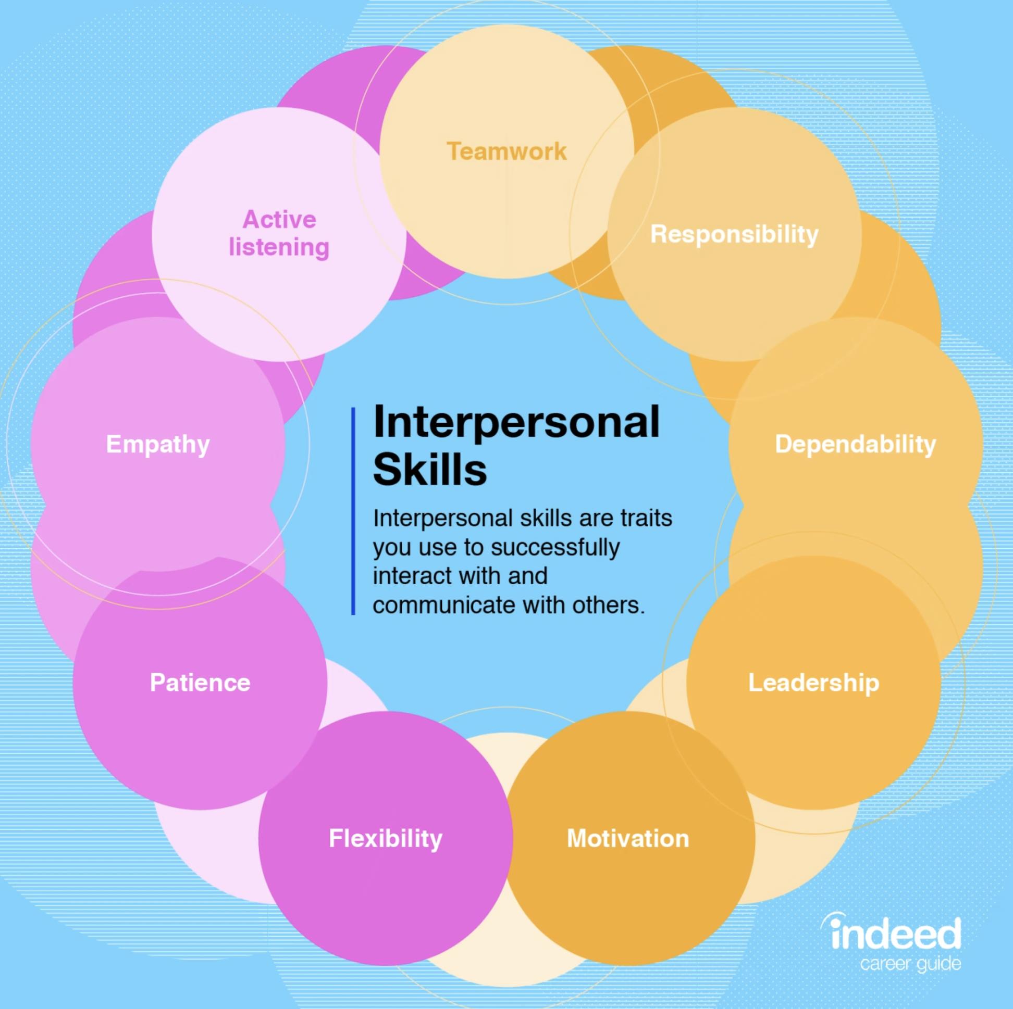
Some examples of interpersonal skills include:
Active listening
Teamwork
Responsibility
Dependability
Leadership
Motivation
Flexibility
Patience
Empathy

Slide 6
Select the most appropriate medium for communicating with library users and coworkers
There are multiple ways to reach out and connect with people.
Think about your intended recipient.
Think about your message.

Slide 7
Resolve conflict in a positive and productive manner
Don't ignore the problem and hope it will get better or go away entirely. It won't.
Take a deep breath and resist the urge to snap back.
Remove emotions from the situation.
Know when to refer the situation to a supervisor.

Slide 8
Practice proactive customer service by anticipating user needs
Look around your library. Would someone new know where to get the information or service they need?
Be active in reaching out to see what is needed.

Slide 9
Use effective verbal and non-verbal communication
Verbal Communication
Non-verbal Communication
Speaking clearly and articulately
Asking questions
Asking for help
Conveying information in an appropriate and timely manner
Listening actively, without interrupting
Receiving and integrating feedback without growing defensive
Providing customer service
Body language and posture
Facial expressions
Sound of our voice, including pitch, tone and volume are also forms of non-verbal communication
Eye contact
Distance between yourself and others

Slide 10
Know how to communicate difficult or sensitive information
1. Know the lines you do not want to cross with both patrons and coworkers.
2. Librarians and library staff cannot be expected to solve all problems for patrons but can find information and resources that can help.
3. When delivering bad news to coworkers or direct reports, allow time for follow-up conversations.

Slide 11
Seek, give, and accept constructive feedback from co-workers, supervisors, and users
1. Telling people uncomfortable things is hard.
2. Frame it as constructive feedback instead of a complaint.
3. Be open to and thoughtful when receiving feedback.

Slide 12
Participate effectively on teams, commit to agreed-upon goals and objectives, communicate respectfully and professionally, and support team decisions
1. Working as part of a team is integral to making a library function.
2. Libraries typically do not have a surplus of people, so every person is important and needs to do their part.
3. Being part of a committee is not always fun but being an active drag on the work the committee is trying to accomplish is unacceptable.

Slide 13
Teamwork skills
Skills for a healthy climate
Skills for an effective group process
Openness
Trust and self-disclosure
Support
Respect
Individual responsibility and accountability
Constructive feedback
Problem solving
Management and organization
Knowledge of roles
https://uwaterloo.ca/centre-for-teaching-excellence/teaching-resources/teaching-tips/tips-students/being-part-team/teamwork-skills-being-effective-group-member

Slide 14
Communication and collaboration tools

Slide 15
These are a few of our favorite things
Communication
Email
Microsoft Teams
Zoom
Communicate in person!
Collaboration
Microsoft Teams
Trello
Google
Collaborate in person!

