Slide 1
Unit 1: Curriculum Internship Competencies & Financial Literacy
[presenter’s names]

Slide 2
Agenda
Introductions/Re-introductions and Welcome
Overview of communication tools
Team’s site, calendars, Chromebooks, mentors, workplace partners
Questions
Workplace Competencies
Technical Competencies
Soft skills
Transferrable skills
Finances
Getting paid, opening a checking account
Paying bills and budgeting (needs, wants, obligations)

Slide 3
Learning Outcomes
Understand the different communication tools to be used for this program.
Learn how to open a checking account.
Understanding the need to live within a budget.
Understanding why your credit score is important.
Understand the importance of being fiscally responsible.

Slide 4
Part 1: Communication Tools

Slide 5
Overview of communication tools
Using your Chromebook
Navigating the Team’s site
Calendars
Email
Phone/text number of mentor
Workplace partner supervisor
Questions

Slide 6
Workplace Competencies
Technical Competencies
Computer skills – not just word processing, how tech savvy are you?
Grow your competencies in this area for better marketability.
Example: have a proficiency at programming and programming languages – online courses can certify you and get your ready to start working!
Soft skills
Oral and written communication skills
Importance of active listening in the workplace
Transferrable skills
Skills you acquire on the job, that you can take with you, to help you apply for other jobs in your future!
Are there professional development opportunities or on the job training? If so, always say, YES! Grow yourself!

Slide 7
Part 2: Finances & Financial Literacy

Slide 8
Getting Paid & Opening a Checking Account
Do you have a checking account?
Things to consider in a checking account:
Monthly maintenance fees
Overdraft and insufficient funds fees
Interest rates
Accessibility
Account use and goals
Checking account:
Open online or in-person
Minimum deposit into account, dependent on the bank and account:
https://www.first.bank/Personal/Spend/Checking-Accounts

Slide 9
What are my goals?
My educational goals are…
My social goals are…
My financial goals are…
My family goals are…
My health/physical goals are…
My recreational goals are…
If you had to prioritize these, what are your top 3?
Short-term, long-term goals?
Adapted from: https://www.practicalmoneyskills.com/assets/pdfs/lessons/lev_4/L4Activities1.pdf

Slide 10
Attaining your goals
What can I be doing right now to work toward my goal(s)?
What resources do I need to achieve these goals?
Adapted from: https://www.practicalmoneyskills.com/assets/pdfs/lessons/lev_4/L4Activities1.pdf

Slide 11
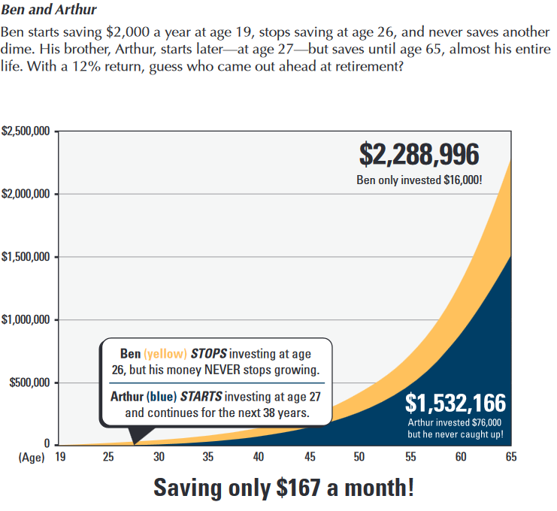
Saving money
Why is this important?
Attaining your goals
Security
How much do you pay yourself out of your paycheck?
Are you seeing any patterns in your spending habits?
How do you decide to make a purchase?
What factors influence you to make a purchase?
https://cdn.ramseysolutions.net/media/pdf/forms/ben_and_arthur_military.pdf

Slide 12
Budgeting
The budgeting process starts with monitoring your current spending.
Evaluating wants, needs, and obligations.
Find a career you might like to pursue, look it up in this Bureau of Labor Statistics Occupational Outlook Handbook:
https://www.bls.gov/ooh/a-z-index.htm
Link to budgeting worksheet.
Adapted from: https://www.practicalmoneyskills.com/assets/pdfs/lessons/lev_4/L4Activities1.pdf

Slide 13
Activity
Let's Learn to calculate our taxes!

Slide 14
Calculating Income Tax
If you work: 720 total hours over the course of 30 weeks (24 hr/week) at $15/hour = $10800
Federal Income Tax max at 10%
FICA Tax ~8%
State Income Tax max at ~6%
STL City tax 1%
Calculating 26% of your income.
10800 x .26 = $2808
Federal = $1080
FICA = $864
State = $648
Local STL = $108

Slide 15
Calculating Income Tax
Scenario:
350 total hours over 2 weeks at $15/hour
Federal Income Tax max at 10%
FICA Tax ~8%
State Income Tax max at ~6%
STL City tax 1%
Calculating 26% of your income.
$405 x .26 = $106
Federal = $40.50
FICA = $32.40
State =
Local STL =

Slide 16
[Month] [Date] @ [Time]am/pm
Reminder about Unit 2 Curriculum

Slide 17
References
Activities. (n.d.). Retrieved February 17, 2022, from https://www.ngpf.org/
ANALYZE: Categorizing Credit. (n.d.). Google Docs. Retrieved February 17, 2022, from https://docs.google.com/document/d/1najungSSd5kAJSoxz3mJ8uSvexiKw4OhKXo0FWwy6Tc/edit?usp=embed_facebook
Checking Accounts. (n.d.). Retrieved February 17, 2022, from https://first.bank/Personal/Spend/Checking-Accounts
College. (n.d.). Retrieved February 17, 2022, from https://www.practicalmoneyskills.com/teach/lesson_plans/college
Dantus –, C.-R. (n.d.). Budgeting: How to create a budget and stick with it. Consumer Financial Protection Bureau. Retrieved February 17, 2022, from https://www.consumerfinance.gov/about-us/blog/budgeting-how-to-create-a-budget-and-stick-with-it/?utm_source=wat&utm_medium=article&utm_campaign=fhi360_1809_art
DeMatteo, M., June 4, L. J. on, & 2019. (2019, June 4). 12 Fun Savings and Budgeting Activities for High School Students. We Are Teachers. https://www.weareteachers.com/saving-budgeting-activities/
Jump$tart’s Reality Check. (n.d.). Jump$tart Coalition. Retrieved February 17, 2022, from https://www.jumpstart.org/what-we-do/support-financial-education/reality-check/

